Slide 1


How to Write and Submit a Conference Abstract
Workshop
24 July 2018

Slide 2
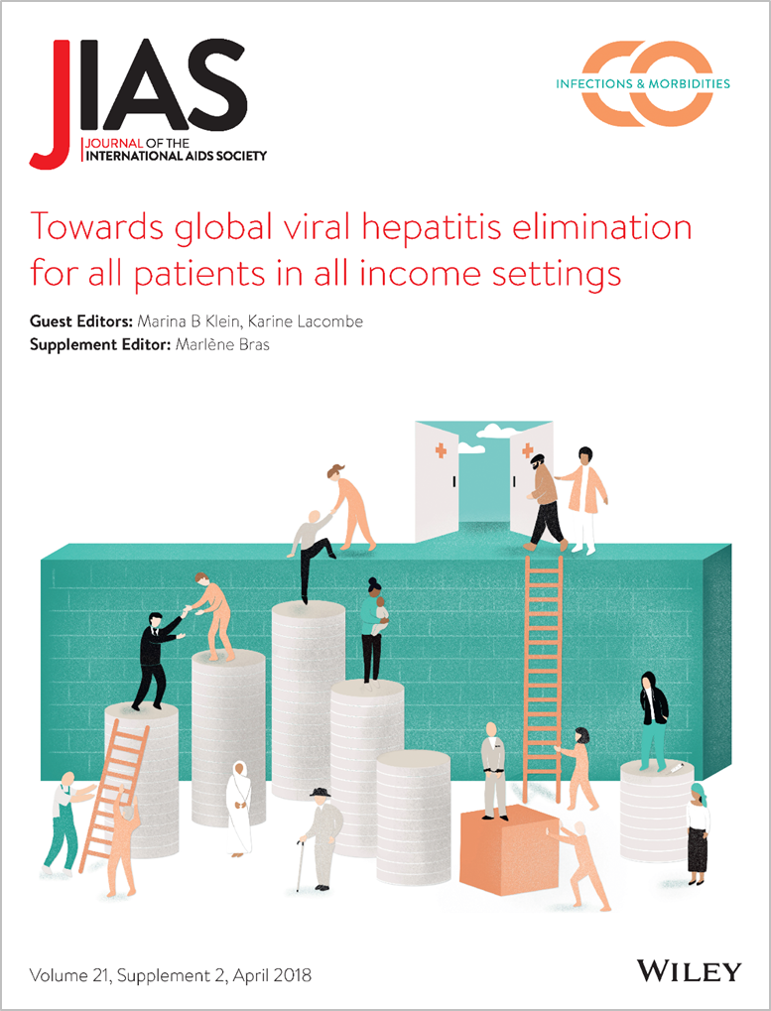
Journal of the International AIDS Society
Our mission and vision is to provide a platform for the dissemination of essential HIV research, to encourage submissions from low- and middle-income countries and to provide capacity building opportunities for less-experienced authors.
Online
Peer-reviewed
Open access
Indexed
Multidisciplinary
Capacity building

Slide 3
Workshop Facilitators
Marlène Bras, Executive Editor
Annette Sohn, Editor-in-Chief
Susan Kippax, Editor-in-Chief

Slide 4
Workshop Agenda
Part One | Introduction to JIAS
 | Abstract structure
 | Writing each abstract section
Part Two | Common mistakes
 | Abstract submission
 | Review and selection
Learning objectives:
1) Write a complete conference abstract that is representative of your study.
2) Understand how an abstract will be scored and reasons for rejection.

Slide 5
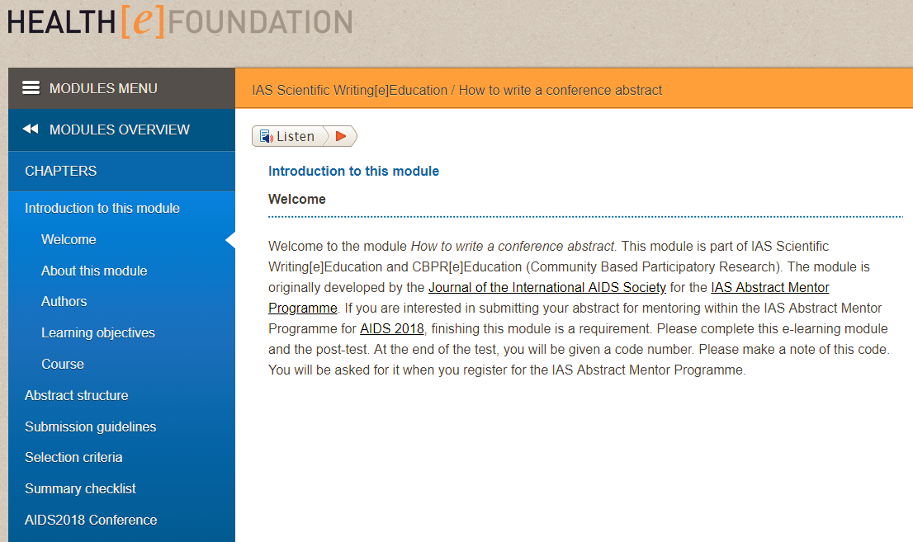
Abstract Writing Online Course
www.healthefoundation.eu

Slide 6

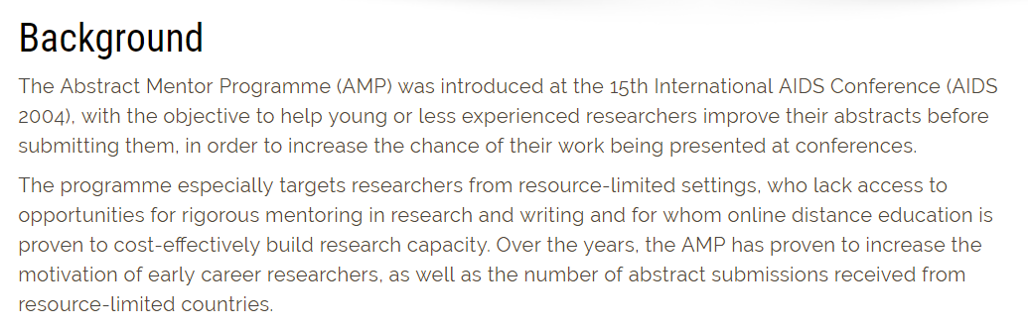
Abstract Mentor Program (AMP)
Participate in the IAS 2019 AMP!

Slide 7
What is an abstract, and what does it include?
Susan Kippax

Slide 8
What is an abstract?
A conference abstract includes all the important details and data from your research study so that it can serve as a stand-alone summary of the work.
Abstract structure
Title: Headline of study with keywords.
Background: Description of issue, knowledge gap and aim.
Methods: Methodology used or approach taken.
Results: Findings and data from study.
Conclusions: Main outcomes and implications.

Slide 9
Writing an abstract:
the TITLE
Choosing a title
Summarize your study in 30-50 words.
Your title should be:
short, specific, representative, informative.
You don’t need to present your lessons learned or recommendations in the title.
The title is your mini-advertisement.

Slide 10

Writing an abstract:
the TITLE
What different types of information does this title contain?
What different types of information does this title contain?
Factors associated with loss to follow-up among women in Option B+ PMTCT programme in northeast Ethiopia: a retrospective cohort study
What? Who? Where? How?
Title 1

Slide 11
Writing an abstract:
the TITLE
WHO
What different types of information does this title contain?
Factors associated with loss to follow-up among women in Option B+ PMTCT programme in northeast Ethiopia: a retrospective cohort study
WHAT
Title 1
WHERE
HOW

Slide 12

Writing an abstract:
the TITLE
What? Who? Where? How?
Title 2
Researching the effects of alcohol on suburban family structure
Title 3
Integrated delivery of antiretroviral treatment and pre‐exposure prophylaxis to HIV‐1 serodiscordant couples in East Africa: a qualitative evaluation study in Uganda

Slide 13
Writing an abstract:
the TITLE
What? Who? Where? How?
Title 2
Researching the effects of alcohol on suburban family structure
Title 3
Integrated delivery of antiretroviral treatment and pre‐exposure prophylaxis to HIV‐1 serodiscordant couples in East Africa: a qualitative evaluation study in Uganda

Slide 14
How to write the BACKGROUND section

Slide 15
Writing an abstract:
the BACKGROUND
What is the topic of the abstract?
Injecting drug users in Eastern Europe
PMTCT coverage in Japan
Why was the study done?
HIV transmission among discordant couples
Low condom use among MSM
What was the aim of the study?
Gather evidence of programme effectiveness
Compare home-based HCT with provider-initiated HCT

Slide 16

Writing an abstract:
the BACKGROUND
Does this background statement answer the following questions?
What is the topic of the abstract?
Why was the study done?
What was the aim of the study?
Ethiopia has recently adopted lifelong antiretroviral therapy (ART) for all HIV-positive pregnant and breastfeeding women (Option B+ strategy), regardless of CD4 count or clinical stage. However, the exact timing and predictors of loss to follow-up (LFU) are unknown. Thus, we examined the levels and determinants of LFU under Option B+ among pregnant and breastfeeding women initiated on lifelong ART for prevention of mother-to-child transmission (PMTCT) in Ethiopia.

Slide 17
Writing an abstract:
the BACKGROUND
Location
Topic
Ethiopia has recently adopted lifelong antiretroviral therapy (ART) for all HIV-positive pregnant and breastfeeding women (Option B+ strategy), regardless of CD4 count or clinical stage. However, the exact timing and predictors of loss to follow-up (LFU) are unknown. Thus, we examined the levels and determinants of LFU under Option B+ among pregnant and breastfeeding women initiated on lifelong ART for prevention of mother-to-child transmission (PMTCT) in Ethiopia.
Issue
Aim

Slide 18

Writing an abstract:
the BACKGROUND
Does this background statement answer the following questions?
What is the topic of the abstract?
Why was the study done?
What was the aim of the study?
Many prevention of mother‐to‐child HIV transmission programmes across Africa initiate HIV‐infected (HIV positive) pregnant women on lifelong antiretroviral therapy (ART) on the first day of antenatal care (“same‐day” initiation). However, there are concerns that same‐day initiation may limit patient preparation before starting ART and contribute to subsequent non‐adherence, disengagement from care and raised viral load. We examined if same‐day initiation was associated with viral suppression and engagement in care during pregnancy in South Africa.

Slide 19
Writing an abstract:
the BACKGROUND
What is the topic of the abstract?
Why was the study done?
What was the aim of the study?
Many prevention of mother‐to‐child HIV transmission programmes across Africa initiate HIV‐infected (HIV positive) pregnant women on lifelong antiretroviral therapy (ART) on the first day of antenatal care (“same‐day” initiation). However, there are concerns that same‐day initiation may limit patient preparation before starting ART and contribute to subsequent non‐adherence, disengagement from care and raised viral load. We examined if same‐day initiation was associated with viral suppression and engagement in care during pregnancy in South Africa.

Slide 20
How to write the METHODS section

Slide 21
Writing an abstract:
the METHODS
 | QUESTION | CATEGORY | EXAMPLES
WHO? | Who was the subject of the study? Who was targeting by the program? | Organism Population Eligibility | “wild-type BALBc mice” “men who have sex with men”
HOW? | How was the study designed? How was the outcome of interest measured? How was the data collected and analysed? | Methodology Tools Statistics | “a retrospective clinical chart review was performed” “in-depth open-ended qualitative interview were conducted” “a fisher’s exact test was used “
WHERE? | Where did the study take place? Where was the project implemented? | Setting | “University College Hospital in Lagos, Nigeria”
WHAT? | What was measured? What were the factors of interest? | Outcome Evaluation Effect | “survival rate over five years” “barriers to implementation”
WHEN? | When did the study take place? When was the programme implemented? | Time | “between March 2015 and June 2017”

Slide 22
Writing an abstract:
the METHODS
We analyzed patient records of 1878 HIV-positive pregnant women and their newborns in a rural PMTCT programme in the Tsholotsho district of Zimbabwe between 2014 and 2017 in a retrospective cohort study. Using binomial regression, we compared vertical HIV transmission rates at six weeks post-partum, and retention rates during the perinatal PMTCT period (at delivery, nevirapine [NVP] initiation at three days post-partum, cotrimoxazole (CTX) initiation at six weeks post-partum, and HIV testing at six weeks post-partum) before and after the introduction of community health worker–based defaulter tracing in the project.
When? Where? What? Who?

Slide 23
Writing an abstract:
the METHODS
HOW
WHO
We analyzed patient records of 1878 HIV-positive pregnant women and their newborns in a rural PMTCT programme in the Tsholotsho district of Zimbabwe between 2014 and 2017 in a retrospective cohort study. Using binomial regression, we compared vertical HIV transmission rates at six weeks post-partum, and retention rates during the perinatal PMTCT period (at delivery, nevirapine [NVP] initiation at three days post-partum, cotrimoxazole (CTX) initiation at six weeks post-partum, and HIV testing at six weeks post-partum) before and after the introduction of community health worker–based defaulter tracing in the project.
WHAT
WHERE

Slide 24

Writing an abstract:
the METHODS
Does this methods section answer the following questions?
When? Where? What? Who?
Sputum samples were collected from patients with tuberculosis at St. George’s Hospital in London, UK between March and December 2017. Samples were tested for multi-drug resistance and correlated with risk factors such as treatment interruption and HIV co-infection.
Who?
Where?
When?
What?
How?
- patients with tuberculosis
- St-George’s Hospital in London, UK
- between March and December 2017
- sputum samples / resistance / risk factor

Slide 25

Writing an abstract:
the METHODS
How could this methods section be improved?
Data were analyzed using multi-variate regression. A survey was conducted on 1045 women, who underwent HIV counselling and testing in STI clinics in New York State. The women’s age ranged from 21-49 years of age. All participants gave written informed consent. Inclusion criteria for the study were female, adult, attending one of the sampled STI clinics. The survey questions were close-ended collecting demographical data, previous history of STI, reasons for attending clinic on day of survey and condom use

Slide 26
Writing an abstract:
the METHODS
Data were analyzed using multi-variate regression.
A survey was conducted on 1045 women, who underwent HIV counselling and testing in STI clinics in New York State.
The women’s age ranged from 21-49 years of age.
All participants gave written informed consent.
Inclusion criteria for the study were female, adult, attending one of the sampled STI clinics.
The survey questions were close-ended collecting demographical data, previous history of STI, reasons for attending clinic on day of survey and condom use
Move to end, add more details (what was analyzed?)
Move to beginning
Move to results
Delete
Shorten
Add more details (study implementation date)

Slide 27
How to write the RESULTS section
Annette Sohn

Slide 28
Writing an abstract:
the RESULTS
Data
Findings
Lessons learned
Results of analysis
What was the knowledge gained?
Past tense
Be specific
Aim of study

Slide 29
Writing an abstract:
the RESULTS
How could this methods section be improved?
Most of the people interviewed indicated that they have ever heard of AIDS, but only a few knew that AIDS was caused by HIV. A significant proportion of the respondents had heard of HIV on the TV or radio and the majority knew a person who had died of an AIDS-related illness within the last year. There was a large difference in knowledge on HIV transmission routes between men and women.

Slide 30
Writing an abstract:
the RESULTS
Most of the people interviewed indicated that they have ever heard of AIDS, but only a few knew that AIDS was caused by HIV. A significant proportion of the respondents had heard of HIV on the TV or radio and the majority knew a person who had died of an AIDS-related illness within the last year. There was a large difference in knowledge on HIV transmission routes between men and women.
Aim 1: Is knowledge of HIV correlated with risky sexual behaviour?
Aim 2: What is the level of knowledge of HIV and what is the source of information.

Slide 31

Writing an abstract:
the RESULTS
Is this a good results section? Why?
Women's average ages were 23.3 and 25.1 years, respectively at Johannesburg and Cape Town, and 93.5% and 96.4% of women were single respectively. A total of 4692 adverse events (AEs) were reported, including one death, 38 other serious AEs, and six fractures. No serious AEs were considered related to use of tenofovir gel. The most frequently reported AEs were influenza (436 patients), vaginal discharge (312 patients) and vaginal candidiasis (244 patients).

Slide 32
Writing an abstract:
the RESULTS
Women's average ages were 23.3 and 25.1 years, respectively at Johannesburg and Cape Town, and 93.5% and 96.4% of women were single respectively. A total of 4692 adverse events (AEs) were reported, including one death, 38 other serious AEs, and six fractures. No serious AEs were considered related to use of tenofovir gel. The most frequently reported AEs were influenza (436 patients), vaginal discharge (312 patients) and vaginal candidiasis (244 patients).
Specific data: numbers, percentages
Logical flow: study population then details on the AEs

Slide 33
Writing an abstract:
the RESULTS
Are graphs and tables allowed and do they count towards your word limit?
Check the abstract submission guidelines
Can the data be more clearly and concisely presented in a graph or table?
Use only one (if substantially enhances presentation of results)
Is the table / graph easily readable and interpretable
Label axes and columns/rows

Slide 34
Writing an abstract:
the RESULTS
TABLES AND GRAPHS
Socio-demographic characteristics | Percent of participants
Male | 49%
Female | 51%
Europe | 21%
Asia | 18%
America | 22%
Africa | 20%
Australia | 19%
Workshop participants were gender-balanced and geographically representative

Slide 35
Writing an abstract:
the RESULTS
TABLES AND GRAPHS
Occupation | Percentage
Researcher | 39%
Lawyer | 2%
Advocate | 7%
Policymaker | 13%
Student | 8%
Health worker | 31% (of which 19% Doctors, 11% Nurses, 1% Counsellors)

Slide 36
How to write the CONCLUSIONS section

Slide 37
Writing an abstract:
the CONCLUSIONS
Summarize main conclusions
Must reflect data as presented in abstract
Interpretation of results
Implications of findings
Recommendations
Future research
Limitations
Key take-home messages
3-4 sentences
AVOID
Obvious statements
Repetition of results
Over-generalizations

Slide 38
Writing an abstract:
the CONCLUSIONS
Example 1
Community involvement in research helped in meeting stringent enrollment targets. With structured programmes for community involvement and appropriate resource allocations, sustainable models of community engagement in research can be developed. A cost effectiveness assessment would be beneficial to support funding applications for these programmes.
Example 2
Taking all our results into consideration and in agreement with previously published reports, we have shown that one in every 500 patients can be affected by adverse reactions to their currently used treatment regimen. Patients on any drug treatment should be closely monitored for adverse reactions as these may lead to increased morbidity.

Slide 39

Writing an abstract:
the CONCLUSIONS
Is this a good conclusions section?
Good safety and immuno-virological efficacy of this triple drug therapy were demonstrated in this population. First line unboosted ATV containing regimen could be an alternative to WHO NNRTI preferred regimens and deserves further evaluation in a comparative study in Africa.

Slide 40
Writing an abstract:
the CONCLUSIONS
Good safety and immuno-virological efficacy of this triple drug therapy were demonstrated in this population.
First line unboosted ATV containing regimen could be an alternative to WHO NNRTI preferred regimens
and deserves further evaluation in a comparative study in Africa.
Summary
Implication
Recommendation

Slide 41
Submission and review
Marlène Bras

Slide 42
GOOD PRACTICE
Watch the word count
Keep your audience and reviewers in mind (international)
Be clear and concise - only include essential information
Check spelling and grammar, ask a colleague for feedback
Comply with the submission guidelines
Notes:
Word count: While people are able to address all of the topics outlined in a longer abstract, there is extra effort and some skill required to be able to communicate all of the information/data in a shorter format. Some conferences are limited to 350 (IAS/AIDS) and others allow 500 (HIV Pediatrics). While you can cut down the Background, there are elements of the Methods and Results that are necessary for a reviewer to consider the quality of your work.

Slide 43
COMMON MISTAKES
Reason and aims for study not clear
Methods section incomplete
The most important results not concisely presented
Conclusions are over-generalized
Implications not highlighted

Slide 44

REASONS FOR REJECTION
Poor scientific content
Fraud (e.g. plagiarism)
Abstracts submitted in the wrong track (or conference)
Abstracts poorly constructed / written
Data presented are too preliminary
Lack of novelty, already published or not sufficient contribution to the field

Slide 45
PLAGIARISM
Original: “Social stigma is severe social disapproval of personal characteristics or beliefs that are perceived to be against cultural norms”
Often social stigma is defined as social disapproval of personal characteristics or beliefs that are perceived to be against cultural norms.
From Wikipedia, available at [http://en.wikipedia.org/wiki/Social_stigma]

Slide 46
PLAGIARISM
Original: “Social stigma is severe social disapproval of personal characteristics or beliefs that are perceived to be against cultural norms”
Often social stigma is defined as social disapproval of personal characteristics or beliefs that are perceived to be against cultural norms.
From Wikipedia, available at [http://en.wikipedia.org/wiki/Social_stigma]
PLAGIARISM!
Correct: The term stigma is used when a person experiences social rejection based on prejudice and discrimination due to personal characteristics or convictions.

Slide 47
Draft abstract
Mentoring
Abstract
Submission
Initial scan
Marathon meeting
Reviewing/scoring
Fraudhunter
Sessions

Slide 48
REVIEWER CRITERIA
Scoring
Are purpose, objectives, issues clearly presented?
Are the methodology, study design appropriate?
Are the results clearly presented?
Are the conclusions supported by the results?
Does the abstract contribute significant new knowledge to the field?

Slide 49
Questions and answers

Slide 50
Useful resources
Health[e]Foundation – E-course on how to write a conference abstract at www.healthefoundation.eu.
International Committee of Medical Journal Editors – Uniform requirements for manuscripts submitted to biomedical journals at www.icmje.org.
Committee on Publication Ethics at www.publicationethics.org.
European Association of Science Editors – Guidelines for authors at www.ease.org.uk.
Wiley Author Services at https://authorservices.wiley.com/author-resources/index.html.

Slide 51

How did we do?
Please take a moment to fill out our evaluation form.
Many thanks for your participation and good luck with your abstracts!

